Slide 1
ARDUINO IOT CLOUD
SAMPLE CLOUD PROGRAM TO CONTROL LED

Slide 2
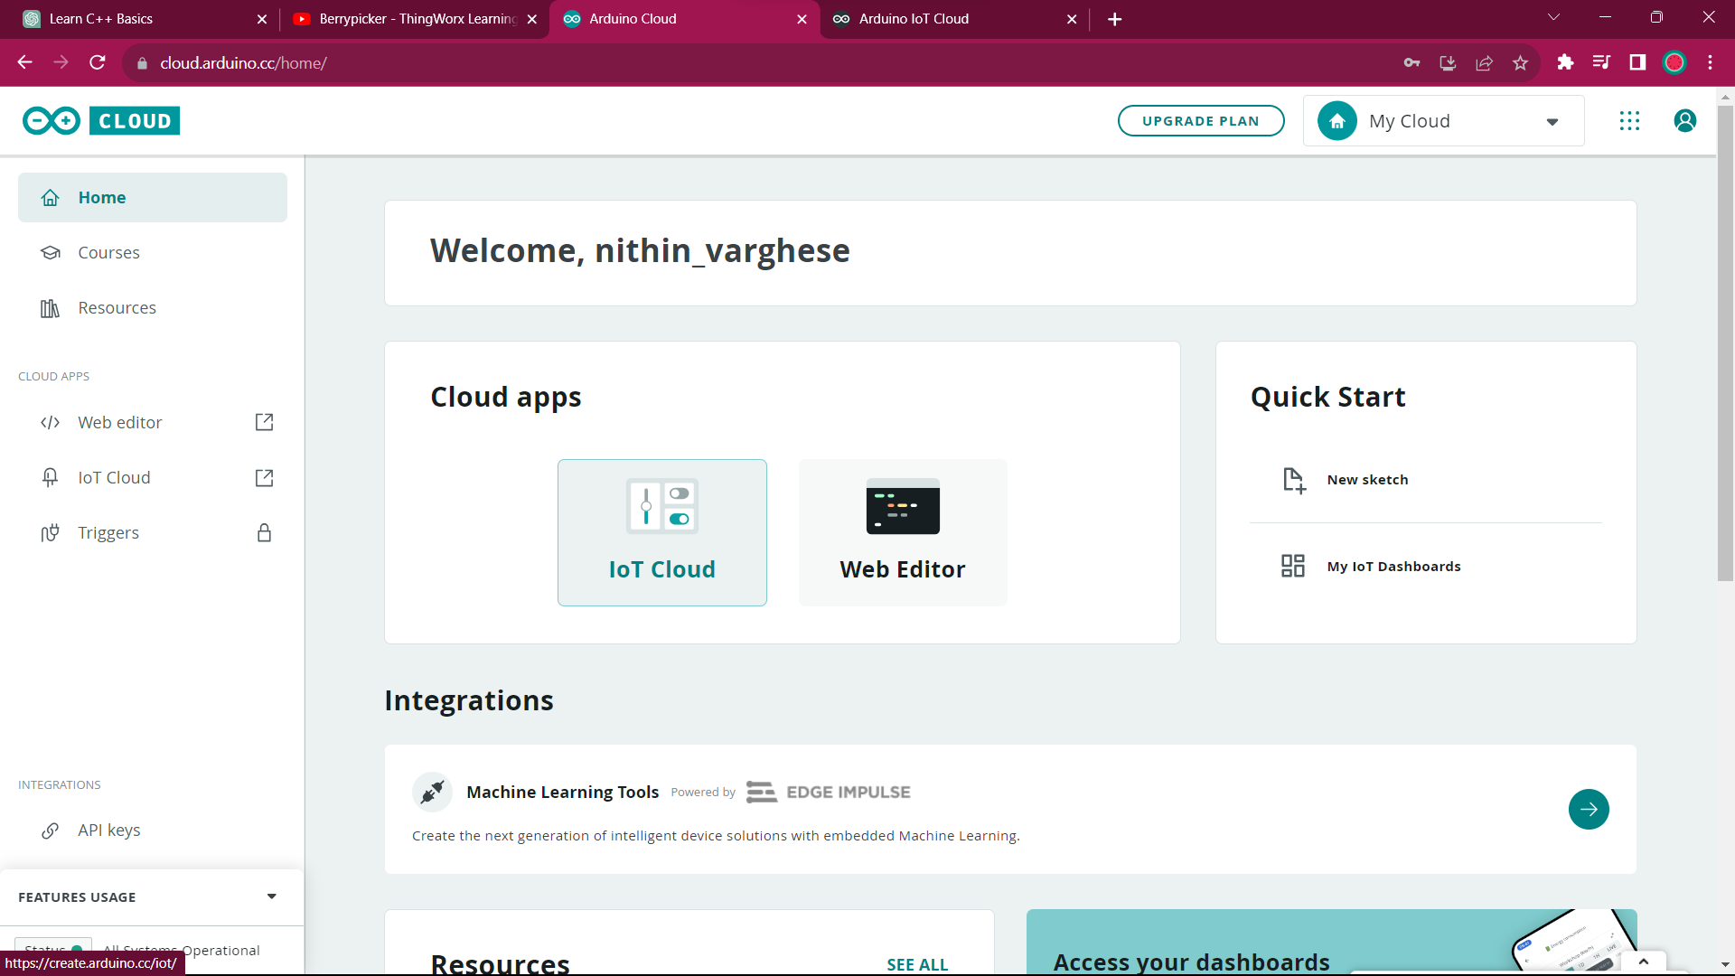
First, create an account and login, then click IOT Cloud

Slide 3
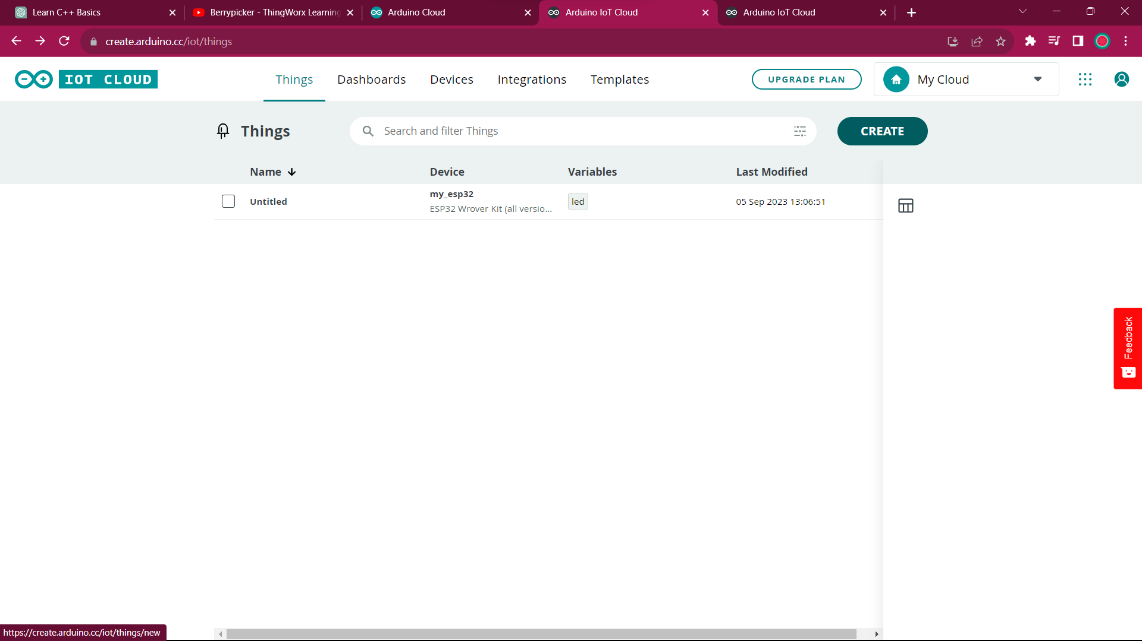
Click create for new project

Slide 4
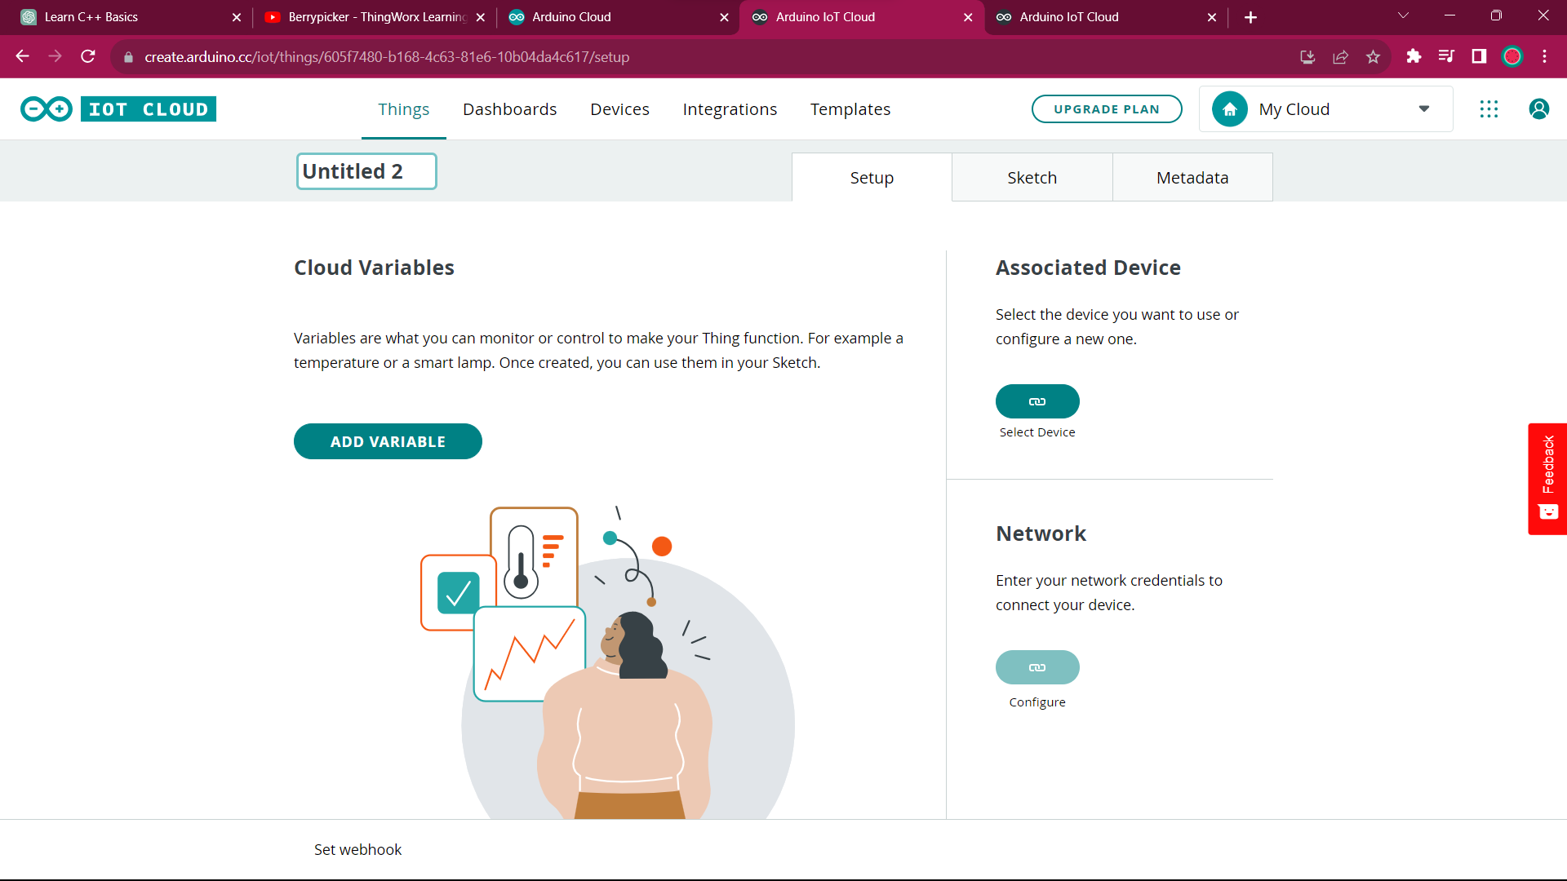
Click on add variable

Slide 5
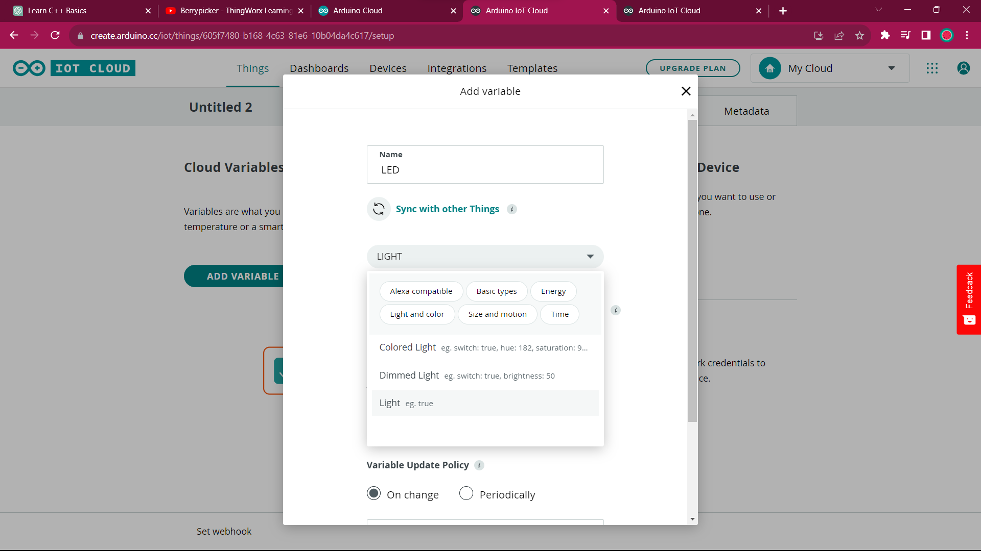
Give variable name and type

Slide 6
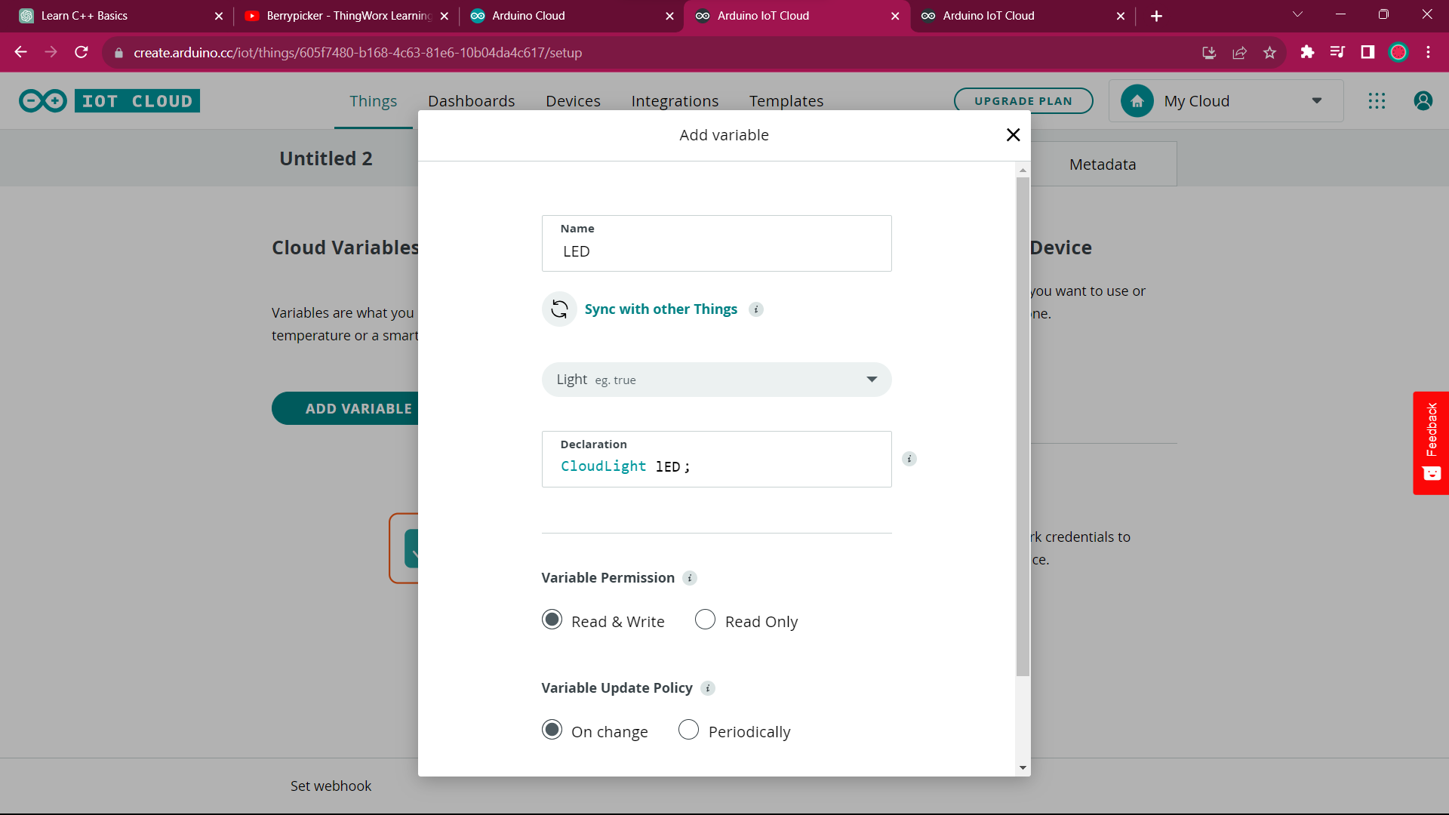
Give variable permissions

Slide 7
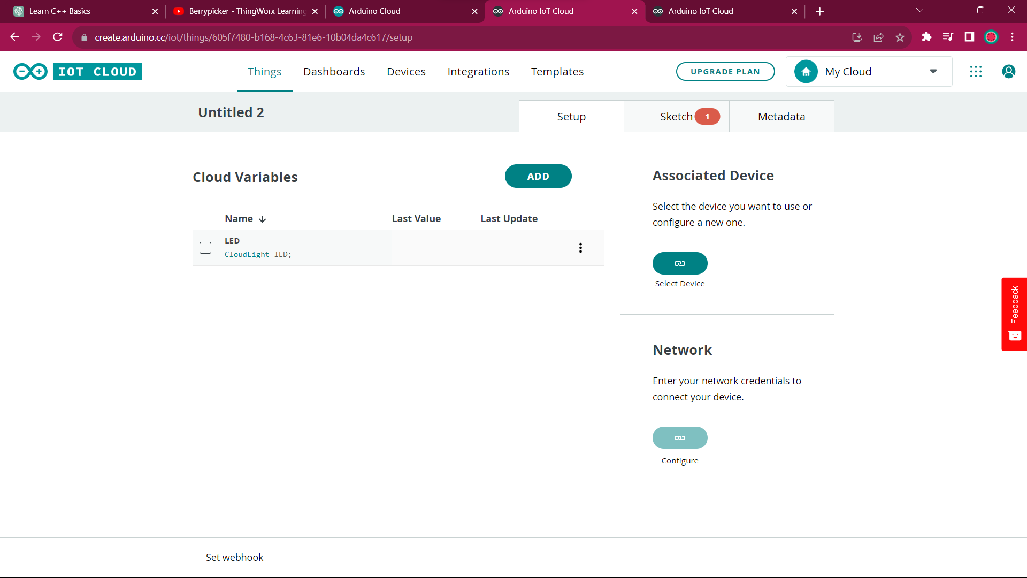
Now click on associated device

Slide 8
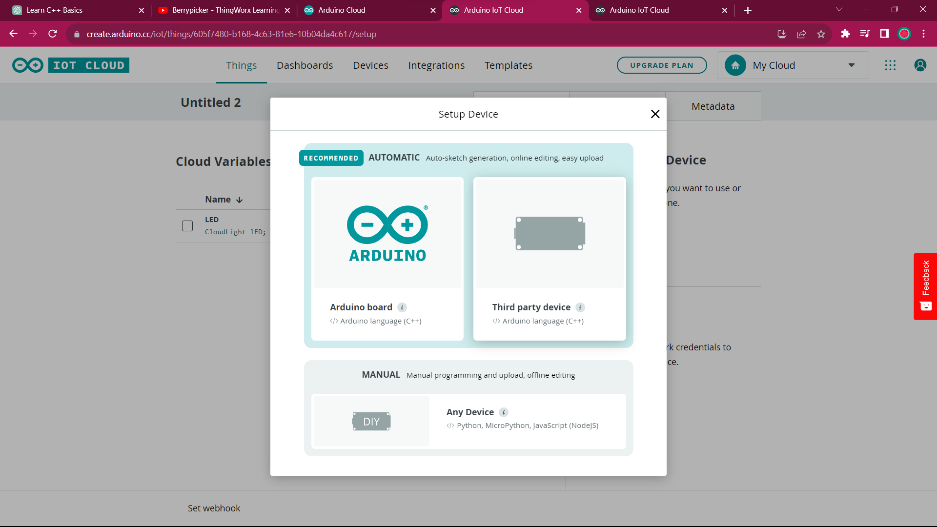
As I want ESP32 click third party device

Slide 9
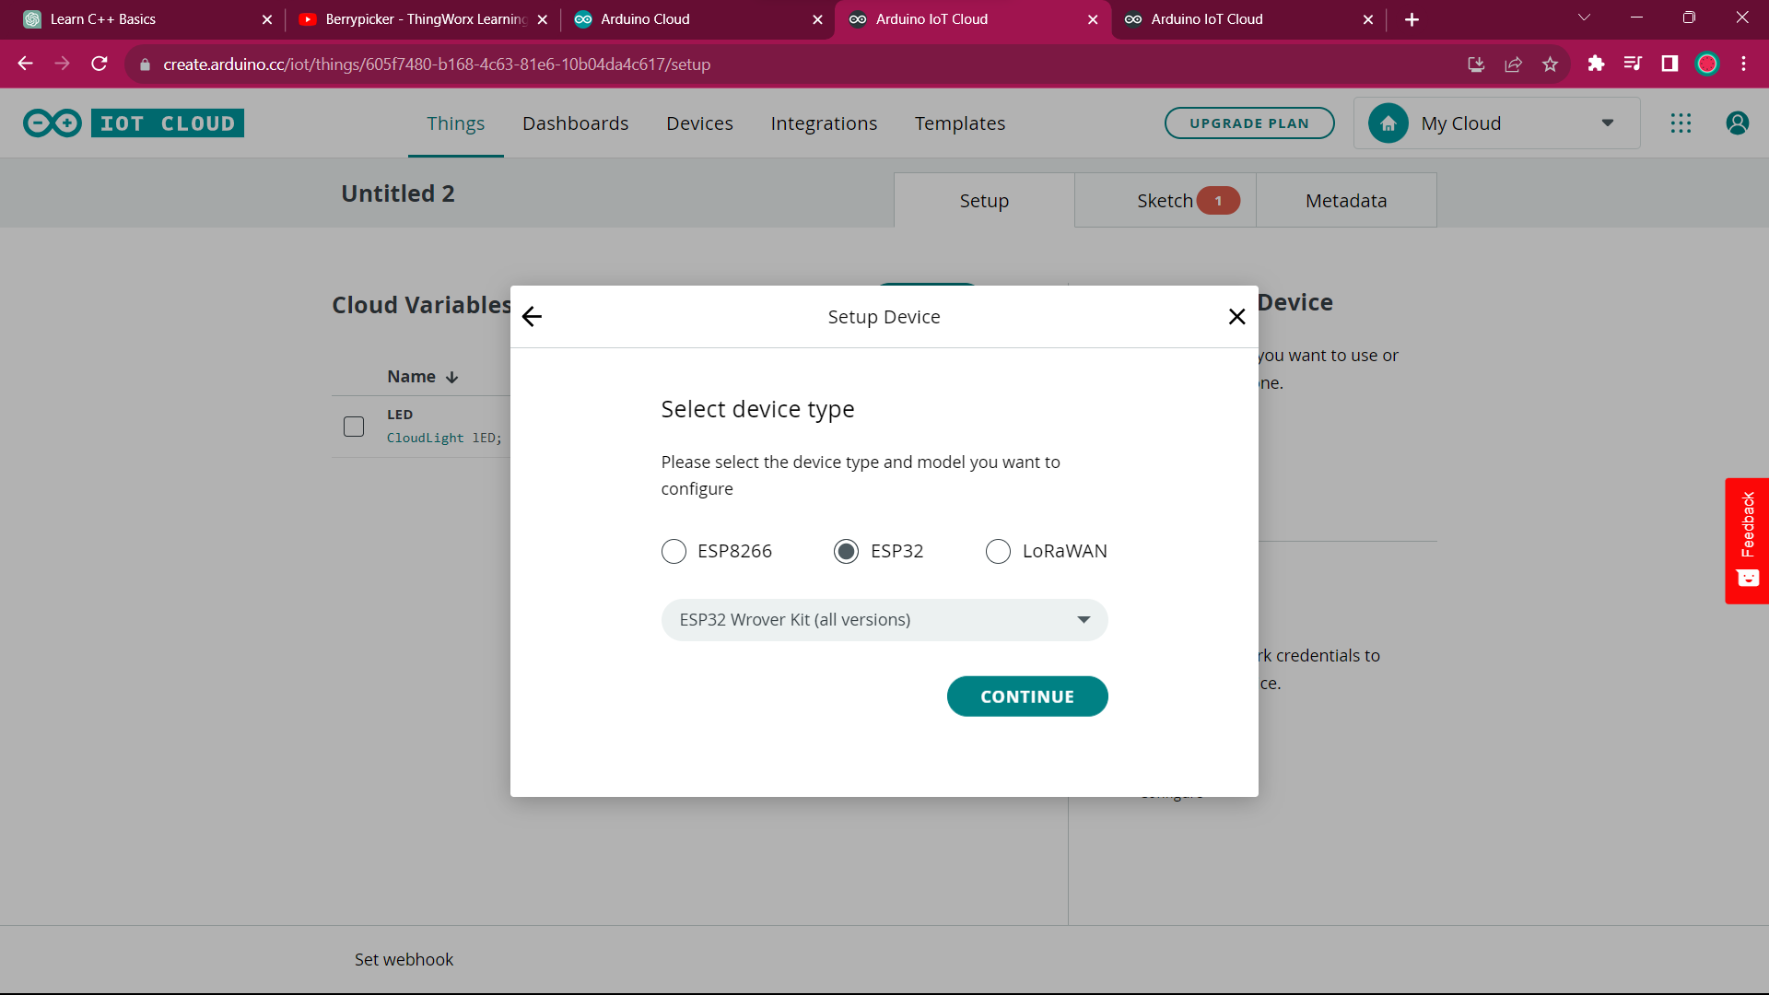
Select ESP32 WROVER KIT FOR ESP32 SIM800L

Slide 10
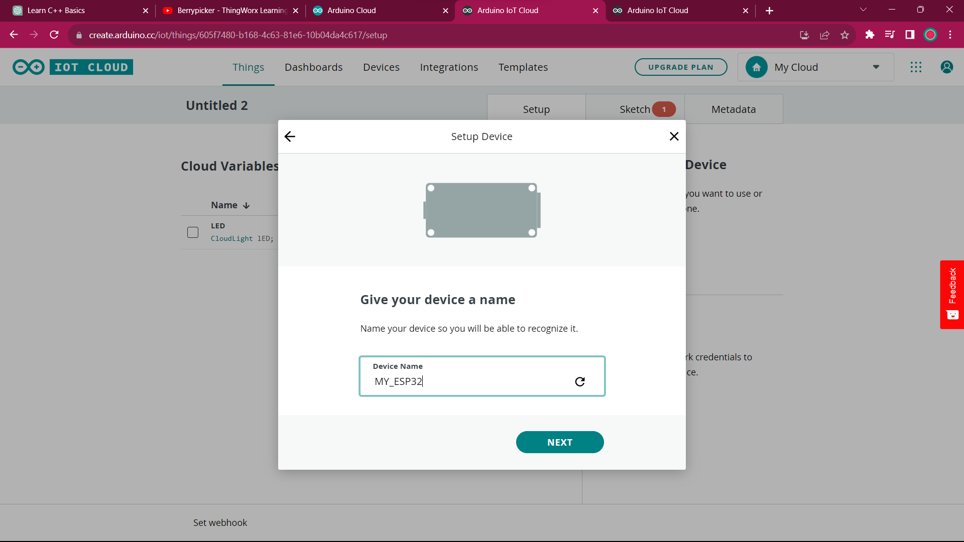
Give a device name

Slide 11
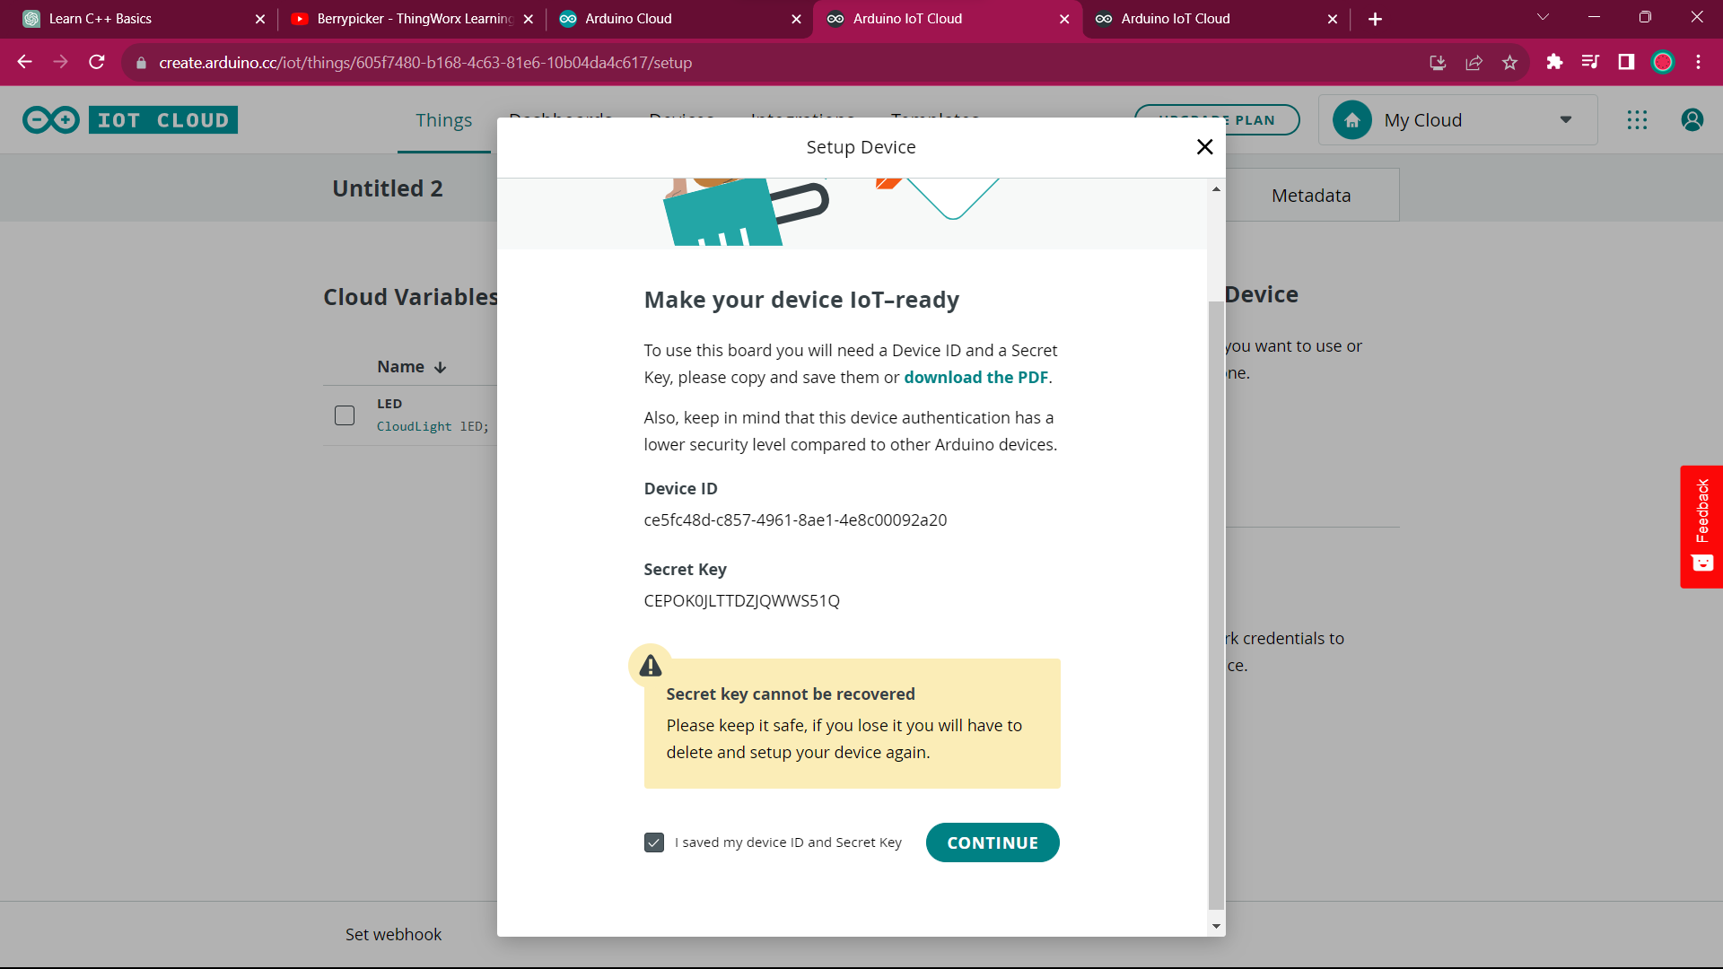
Download the PDF and click continue

Slide 12
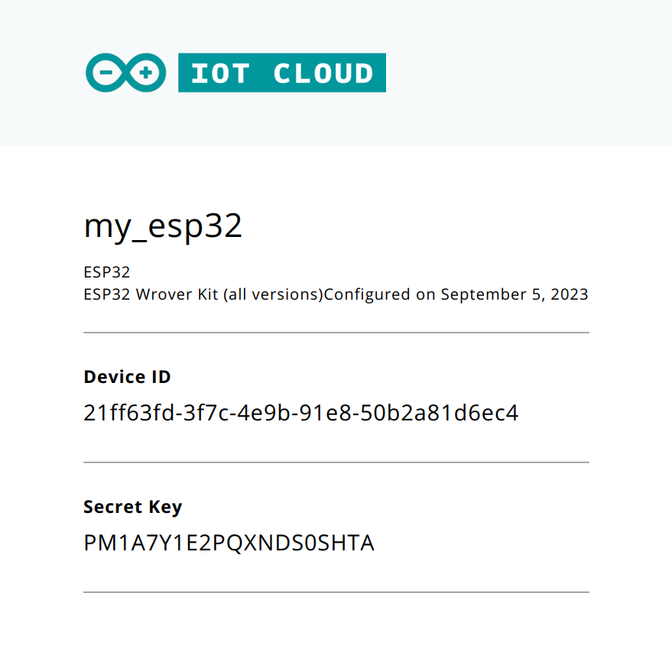
Save it for using in code , we want secret key

Slide 13
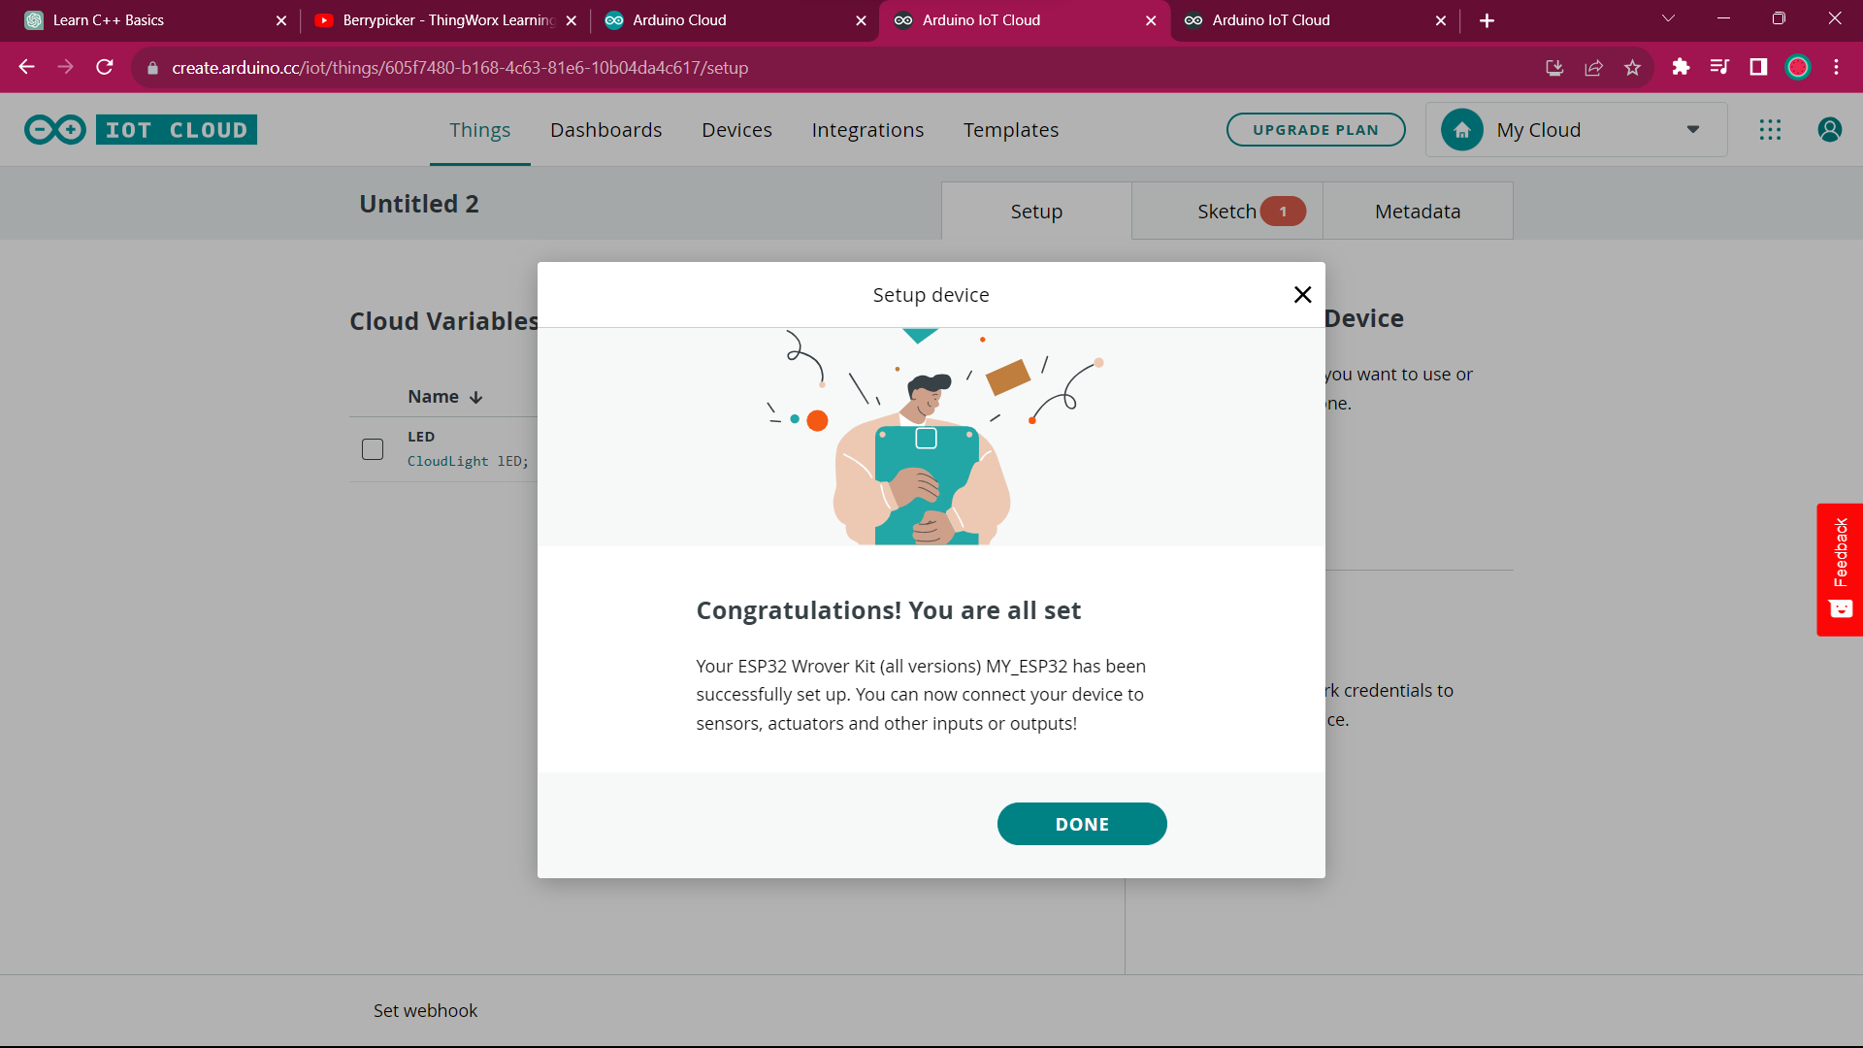
Device is set

Slide 14
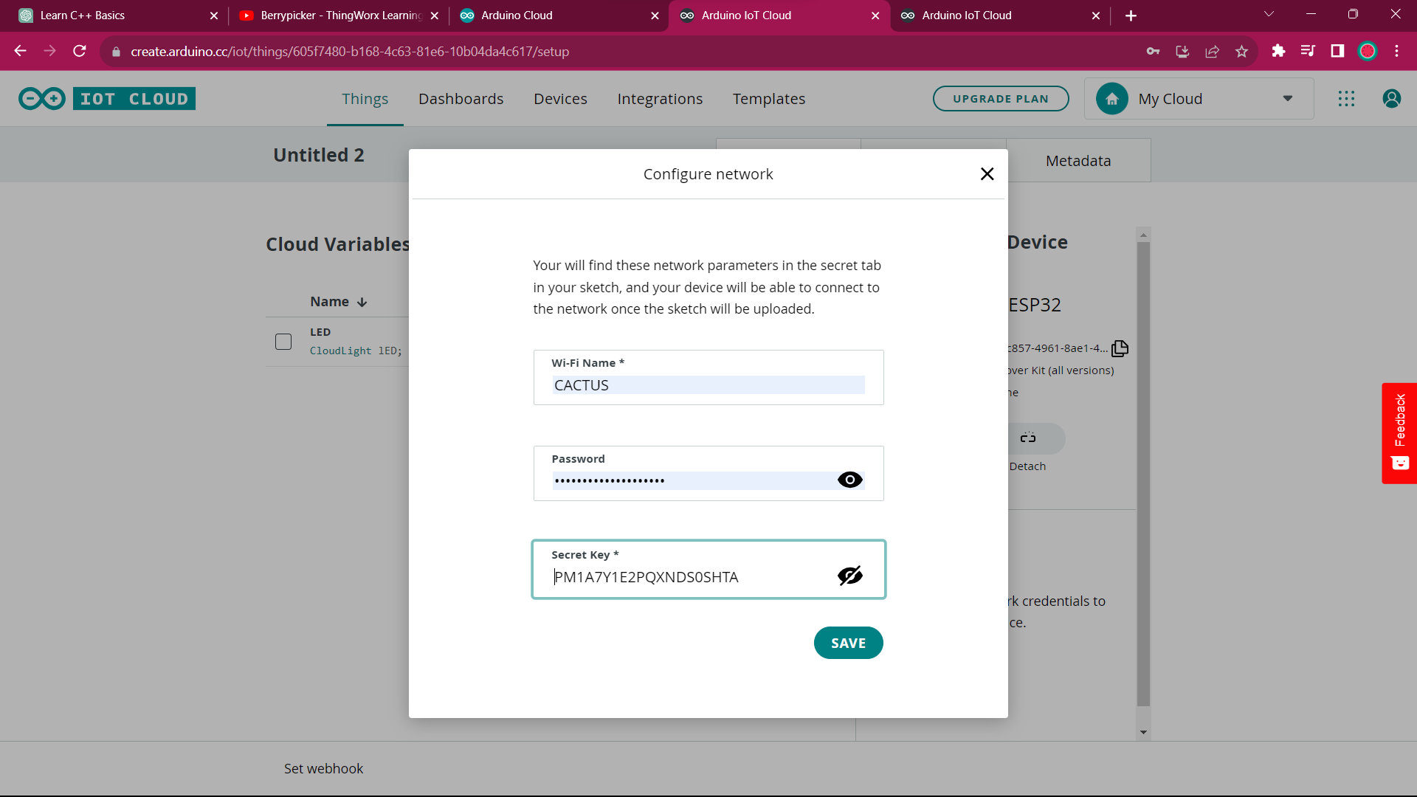
Now configure network for target board to access and provide secret key

Slide 15
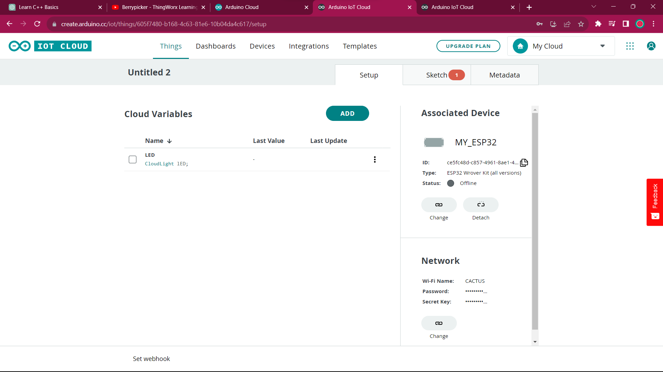

Settings done, now go to sketch

Slide 16
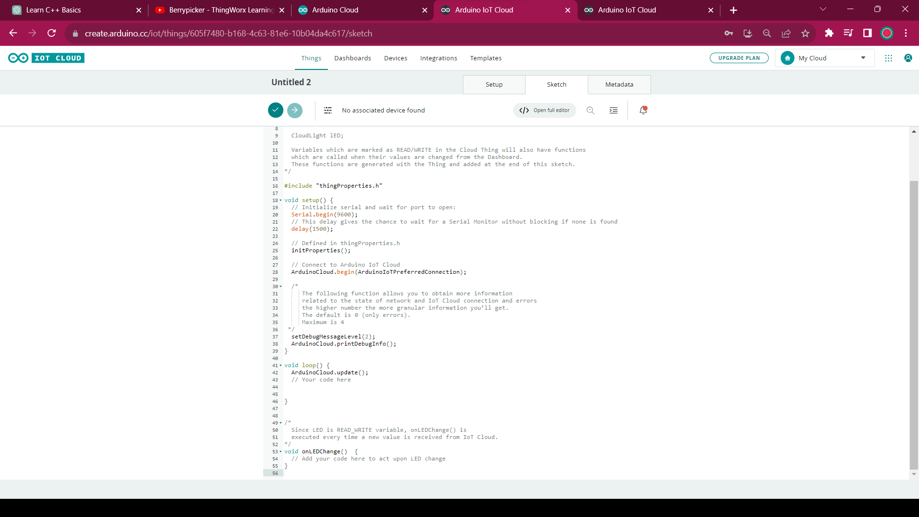

You can see, almost code is already provided, just code the logical function portion

Slide 17
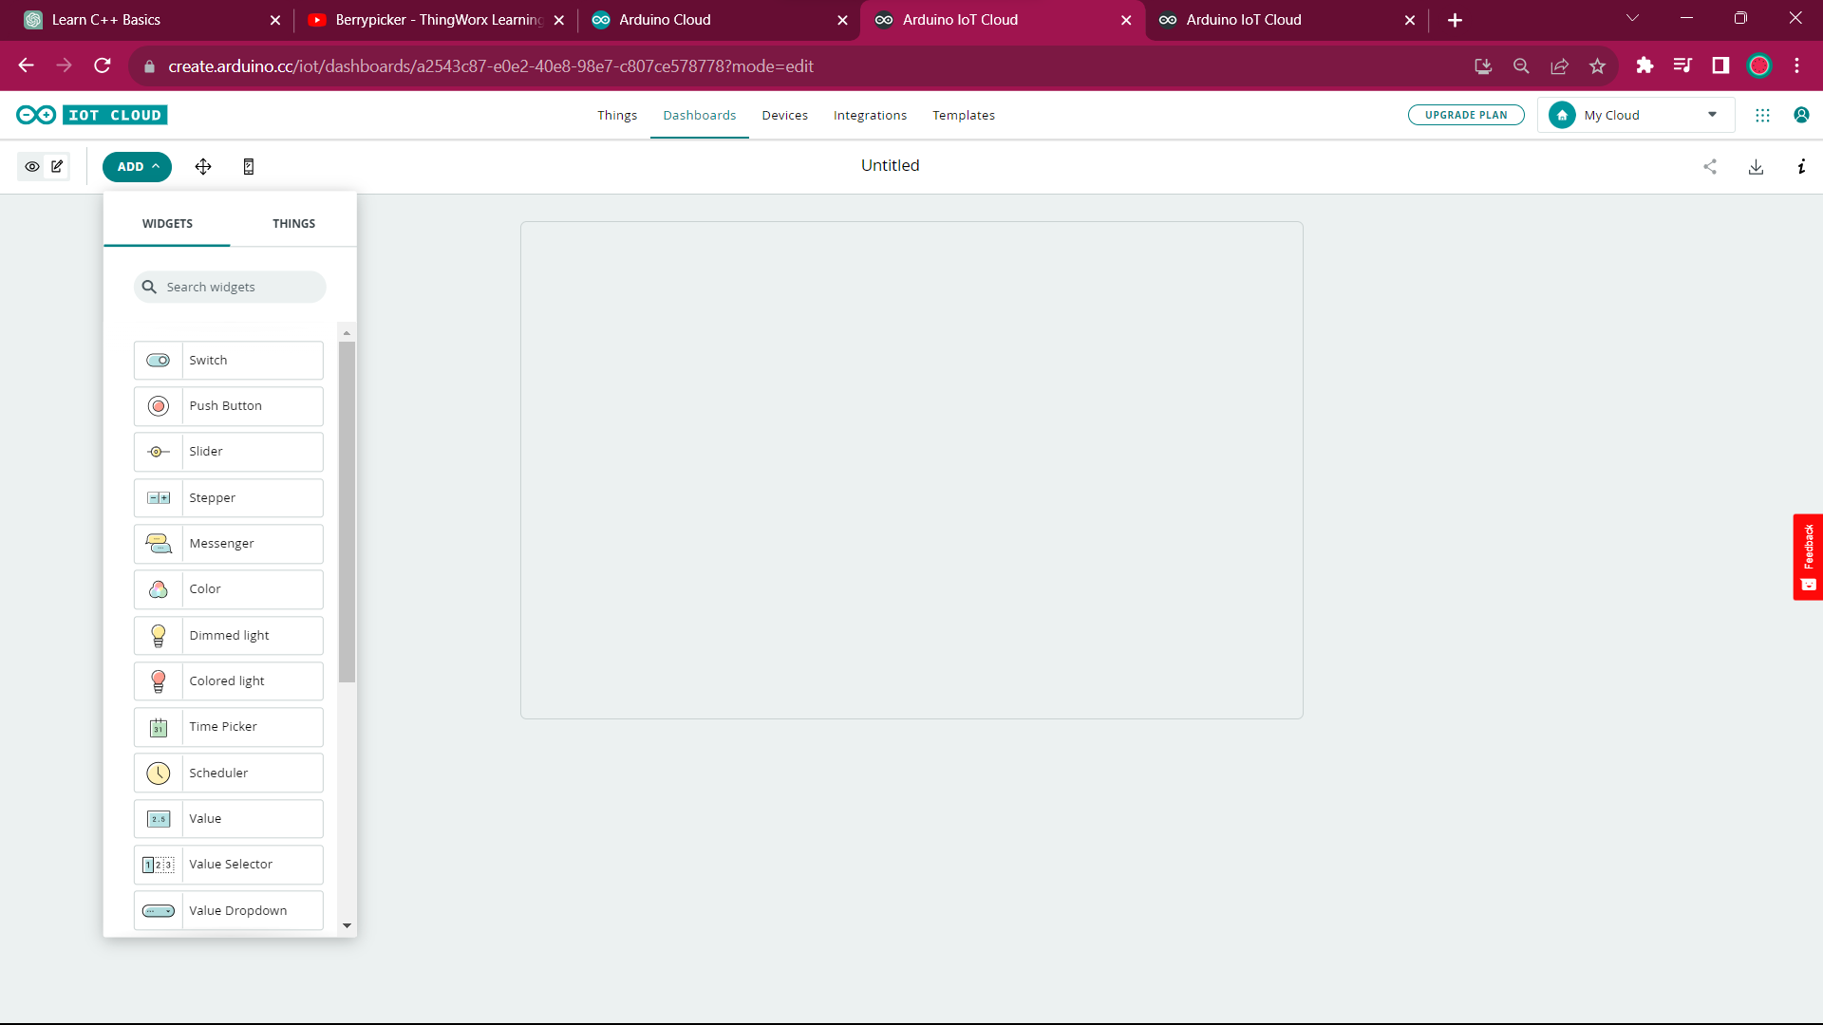

After coding, go to dashboard and select needed widget

Slide 18
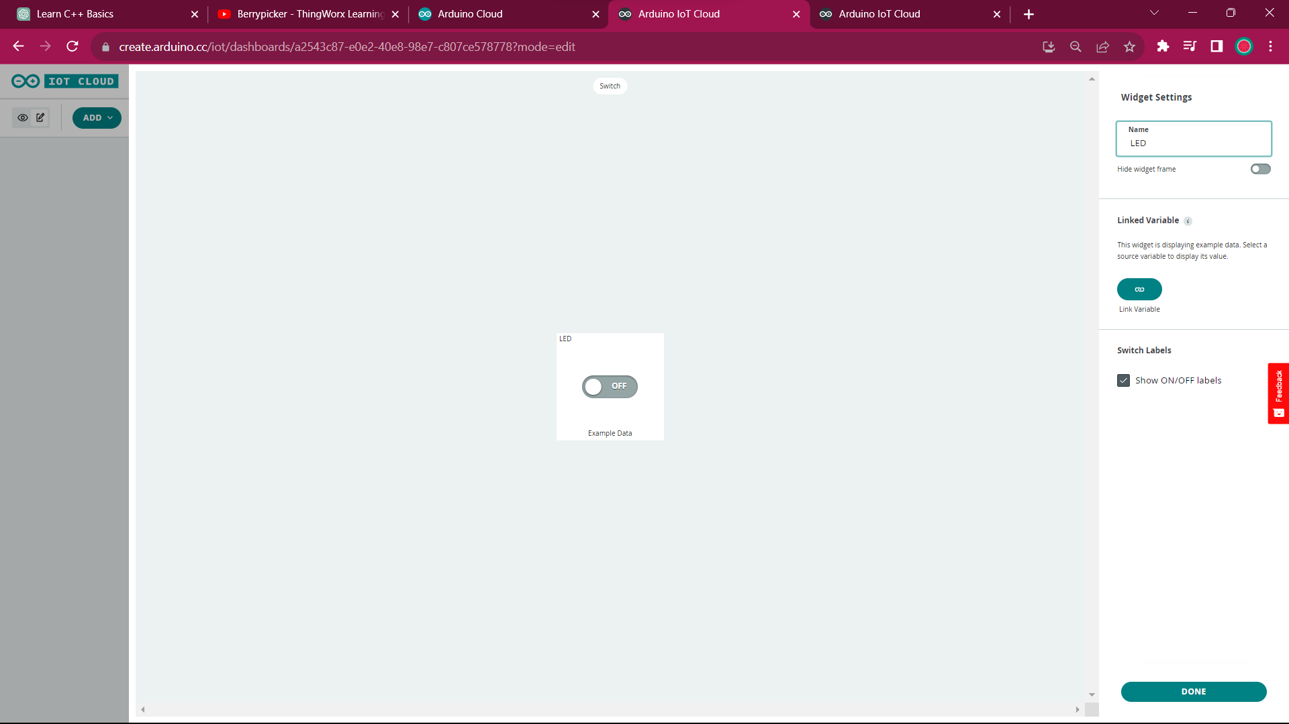


I've selected a switch, give proper settings

Slide 19
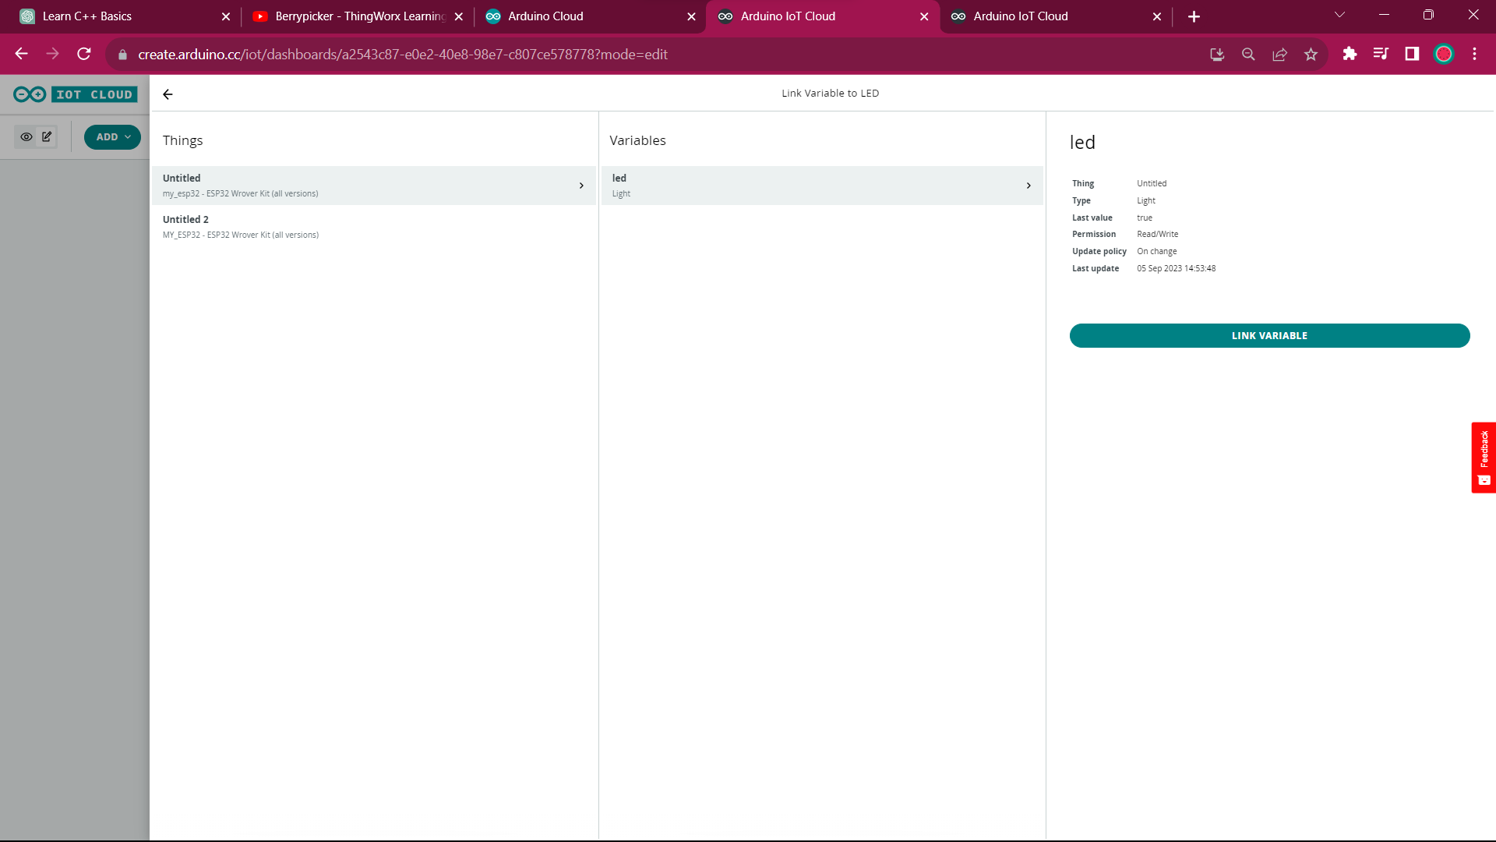

Click link the variable and link widget to the proper variable

Slide 20
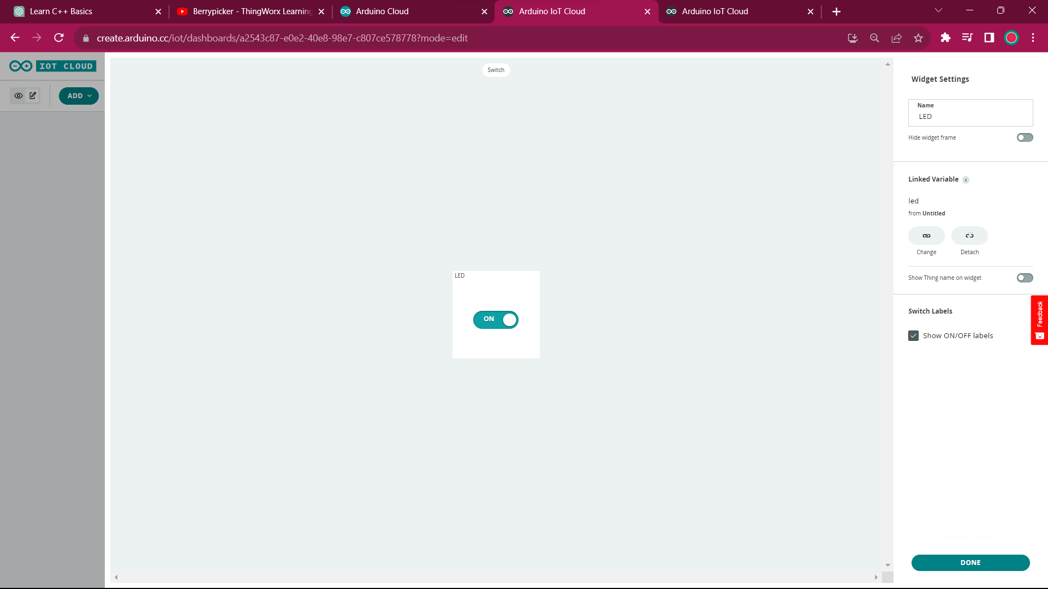

Done with dashboard

Slide 21
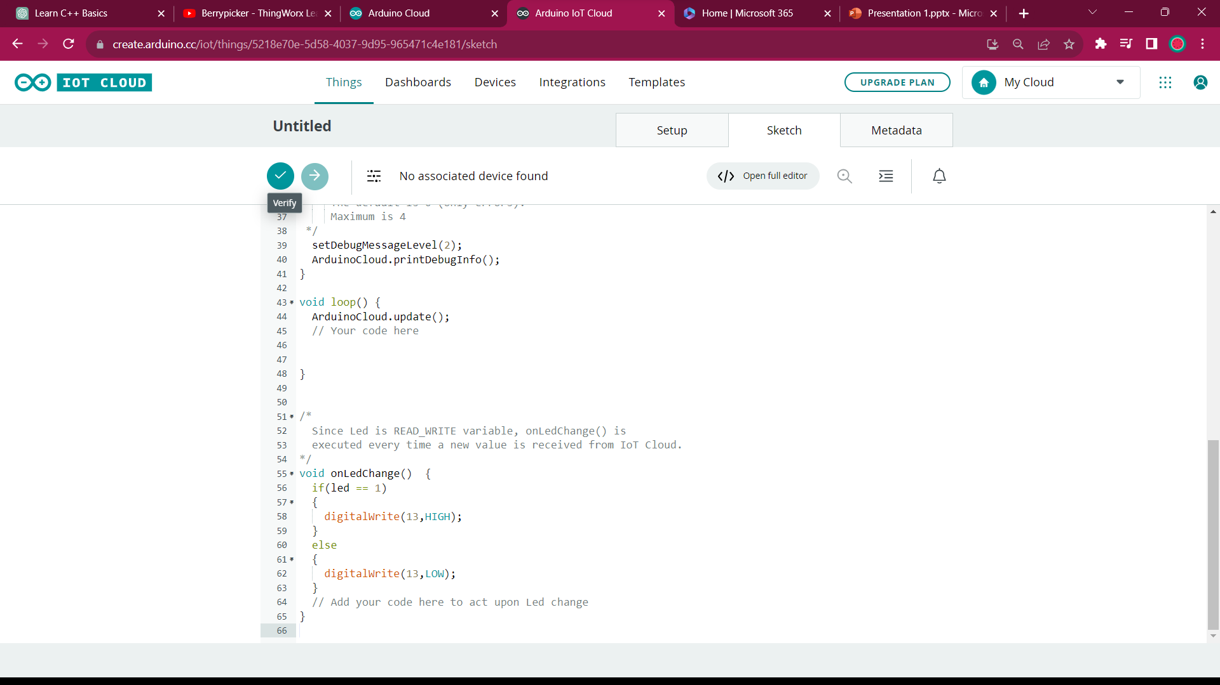

Goto code section, verify and upload

Slide 22
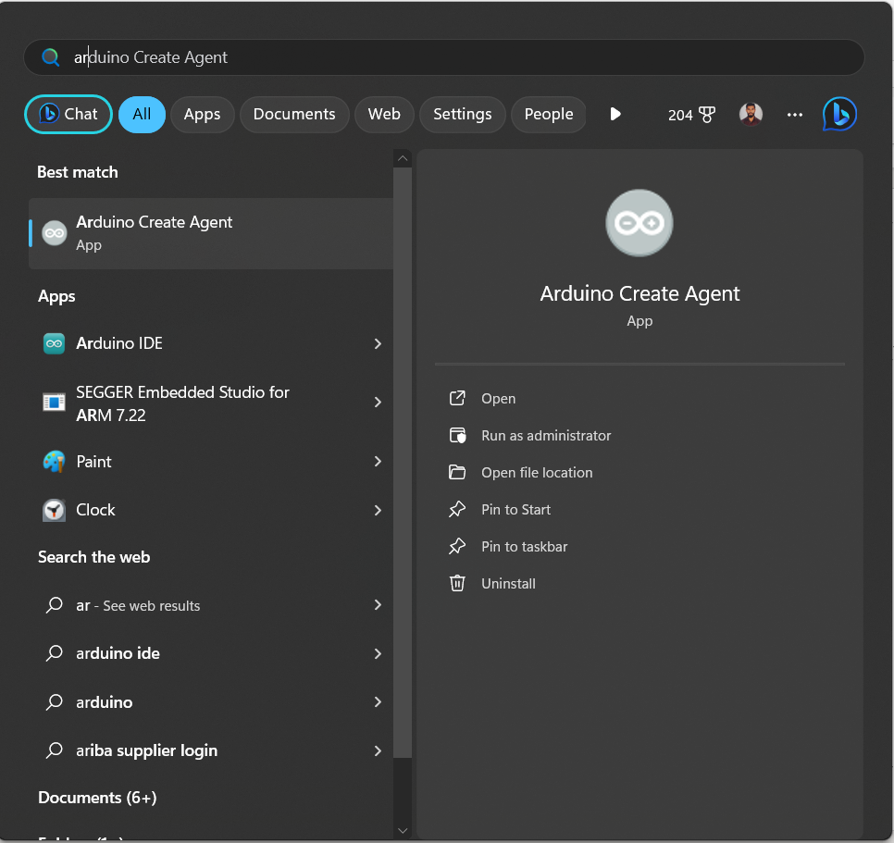

For uploading, download and install arduino create agent

Slide 23



After uploading ,you can just power up the device , and open dashboard for switch controls. You can control the onboard led on 13 th pin through cloud

